Slide 1
MY LITTLE SPACE SHIP
2017311512 강남구
2017312703 김남현

Slide 2
MY LITTLE SPACE SHIP
INDEX
INTRODUCTION
CLASSES
TUTORIALS
Q&A

Slide 3

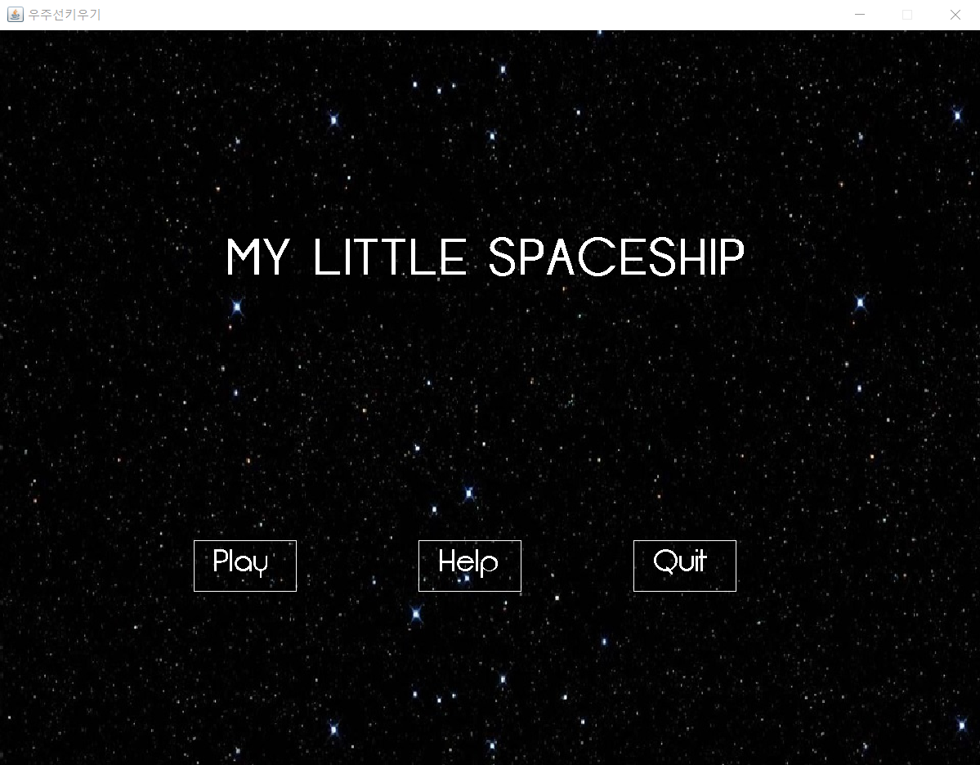
INTRODUCTION
게임 장르
육성, 슈팅게임
게임 목표
나만의 작고 귀여운 우주선을
외계인들을 사냥하여 강하게 만들자

Slide 4

MY LITTLE SPACE SHIP
CLASSES
Game
Main
Controller
GameObject
Boss
Enemy
Market
Menu
MouseInput
SpriteSheet
Keyinput
Wallet
LoadImage
Texture
Physics
InterfaceA
InterfaceB
Bullet
Player

Slide 5
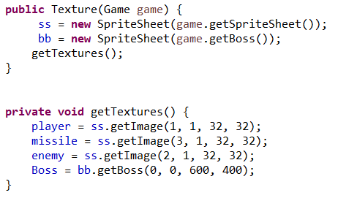
MY LITTLE SPACE SHIP
CLASSES – Texture

Slide 6
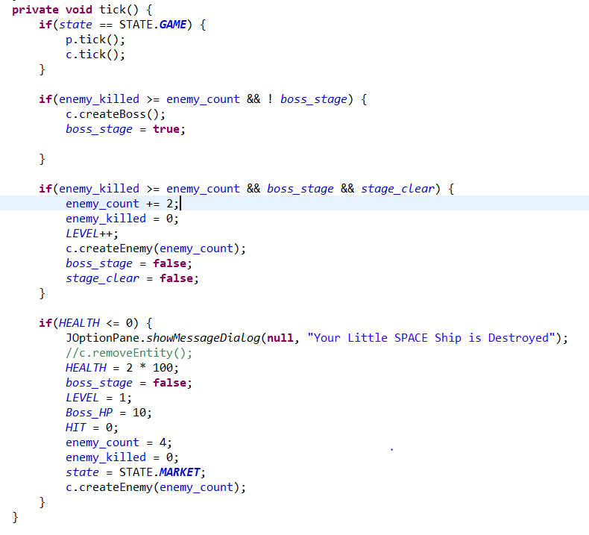
MY LITTLE SPACE SHIP
CLASSES – Game

Slide 7
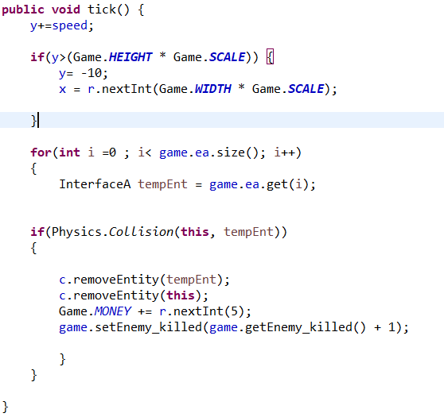
MY LITTLE SPACE SHIP
CLASSES – Enemy

Slide 8
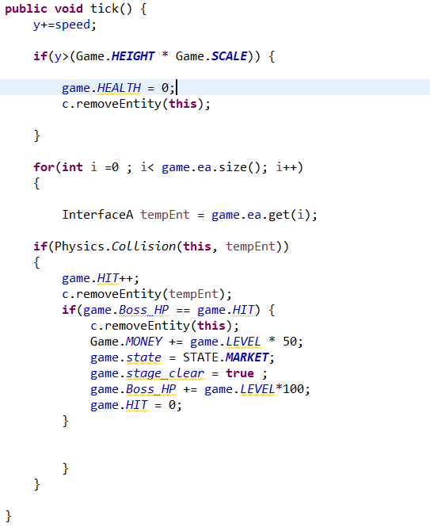
MY LITTLE SPACE SHIP
CLASSES – Boss

Slide 9
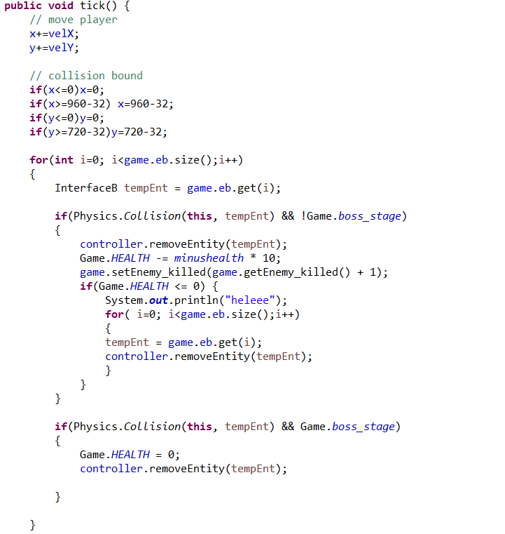
MY LITTLE SPACE SHIP
CLASSES – Player

Slide 10
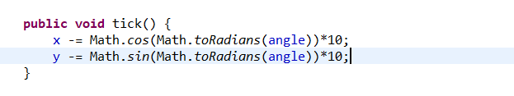
MY LITTLE SPACE SHIP
CLASSES – Bullet

Slide 11
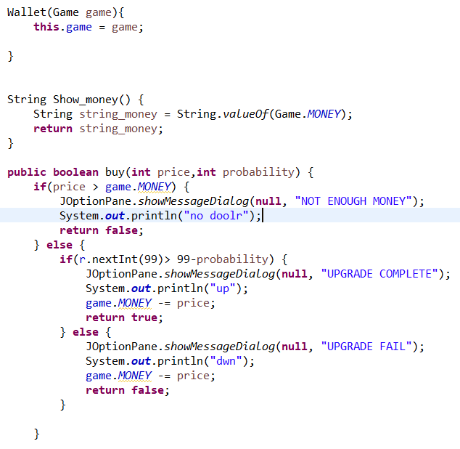
MY LITTLE SPACE SHIP
CLASSES – Wallet

Slide 12
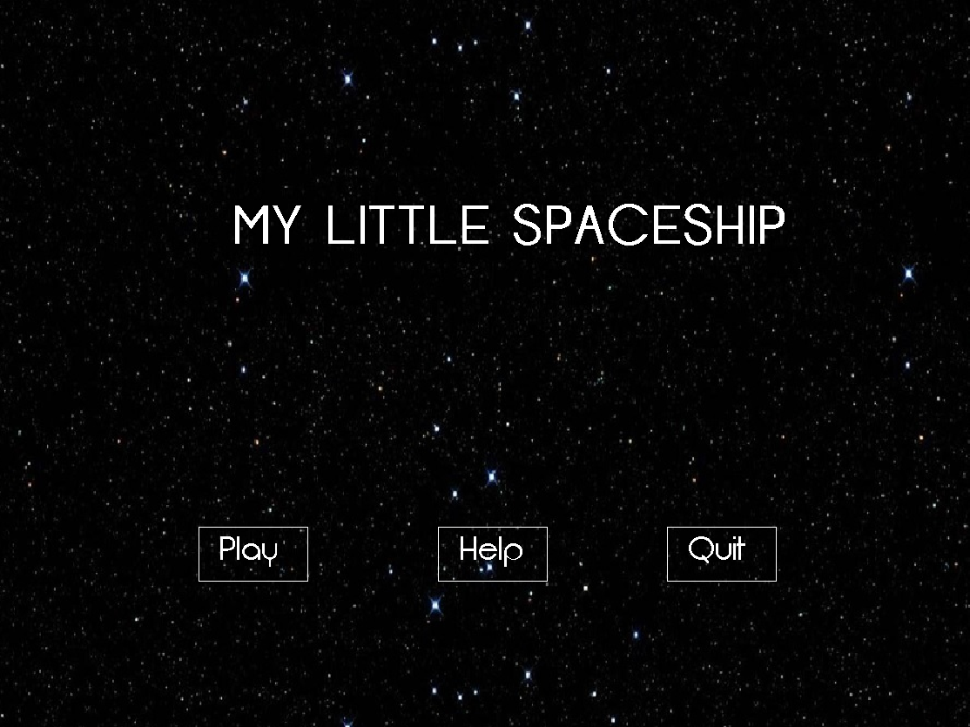
MY LITTLE SPACE SHIP
CLASSES – Menu

Slide 13
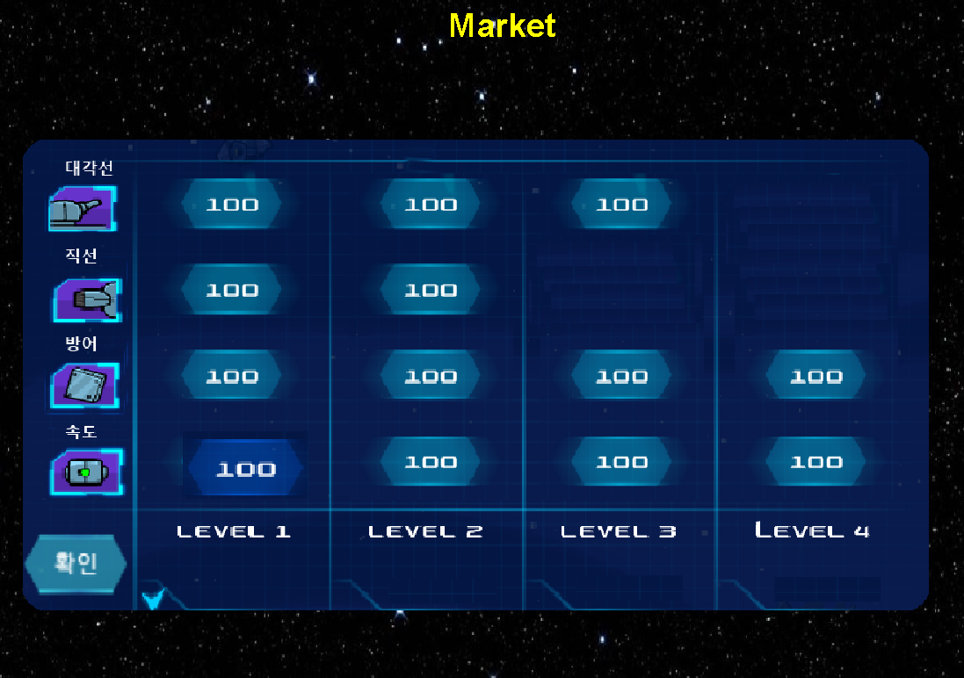
MY LITTLE SPACE SHIP
CLASSES – Mouse Input & Market

Slide 14

TEST

Slide 15
Git Hub
https://github.com/Nam-gu/SoftwarePractice-Project
https://github.com/palabear/SoftWare-Practice-Porject

Slide 16
Q & A

